Slide 1
POLICE STATION

Slide 2
ABSTRACT

Slide 3
This Synopsys documents the process of designing, building and testing this web based application system to be used for marketing. The “Police station “ is a web based application .This application provides facility for reporting, crimes, complaints, show most wanted person details online. Any number of clients can connect to the server. Each user first makes their login to sever to show their availability.
There are 3 types of users in our system.1st one is super administrator. This post is allotted for higher authority of ministry. 2nd one is allotted for officer in-charge of any police station.. And the final one is allotted for civilian to acknowledge them about criminal activities.

Slide 4
1.Administrator: The duty of the super administrator is to authenticate police stations and control the users.. He can also search for any information regarding this system.
2.Station : The police station can maintain the local area`s citizen information database .and he can generate fir and gd.
3.User : citizen able to search for criminal activities, Report incidents and users can able to file any complaints and also get alerted. The Police station is python web application with Django framework . Sqlite is used for the database applications .

Slide 5
Data Flow Diagram

Slide 6
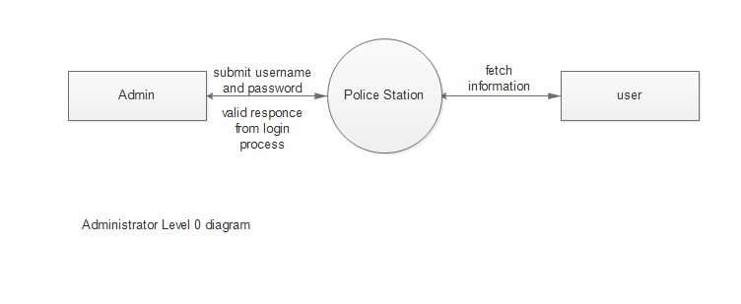

Slide 7
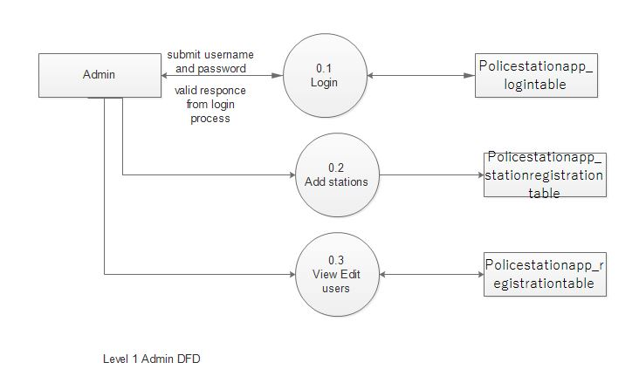

Slide 8
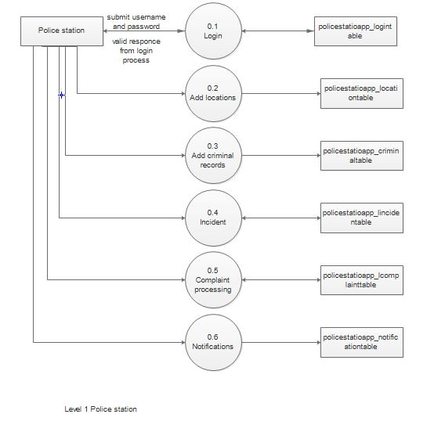

Slide 9
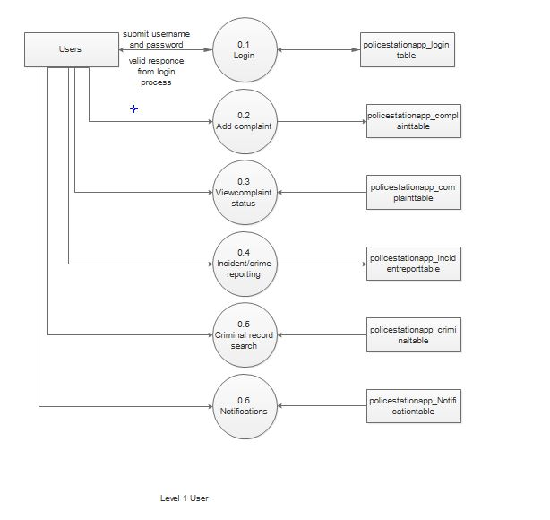

Slide 10
FUNCTIONS OF EACH MODULE

Slide 11
Functions of Administrator
Add stations: Add new stations to the Database for Station login and its further operations
View Users: View the users/civiliance who log in to the system. Admin can edit the users details when needed . And delete operation can also performed.
View stations: Admin can view and edit the stations. The edit is necessary for
Certain updations.

Slide 12
Functions of Administrator
Add stations: Add new stations to the Database for Station login and its further operations
View Users: View the users/civiliance who log in to the system. Admin can edit the users details when needed . And delete operation can also performed.
View stations: Admin can view and edit the stations. The edit is necessary for
Certain updations.

Slide 13
Functions of Station
Add Locations: The Login station can loginto the account and then locations of that station circle can be added to the database.
Criminal: Similar to FIR record . In this the station officer can add criminal details to the database . Also this public persons can also view the criminal details.
Incident: The station officer can view the incidents that reported by the public persons. By this the station officer can take actions to that particular incident immediately.

Slide 14
Complaint: In this feature, the station officer can view all the complaints that register by the public User. In this section, The station officer can take immediate actions to that complaint and also
the user get notifications after take necessary actions to this complaint.
The user report incident near to his stations. The user can choose the stations from the list. That is , nearest police station.
Notification: In this , the station officer can add new notifications . This is the news letter to the public people. Any news or program can be inform by this medium.

Slide 15
View location: The station officer can view the locations . This helps to identify the places under the police station.
View and Edit notifications: The station officer can edit the notifications if the notice period of the notification is expired. This is manually completing the process.

Slide 16
Functions Of User
Registration: The user need to complte the first time registration to log into the website. In registration the user need to enter all the details. This account is necessory for specific applications.
Complaint: In this module , the user can register petitions or complaint . By doing this , the user saves lots of time and effort compared to manual police station. The user can register complaints with all the details and the station officer can take any actions to the petition.

Slide 17
Criminals: The users can view the criminal records. The users can see the case and all of its details and status of that case. That is users can simply view the court status of that case .
Incident : The users can report Incidents to its nearest police station. In this feature users can specify location, date and time of the incident and other details can report to the police stations.
Complaint status : The users can view the complaint status by clicking the button. This feature allow the users to view the live status of the complaint without going to the police station.

Slide 18
DATABASE DESIGN

Slide 19
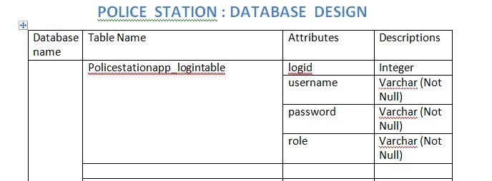

Slide 20
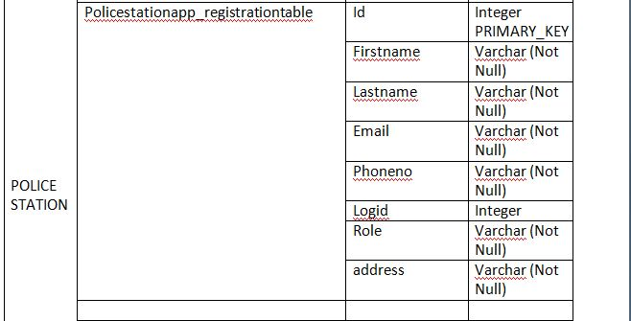

Slide 21
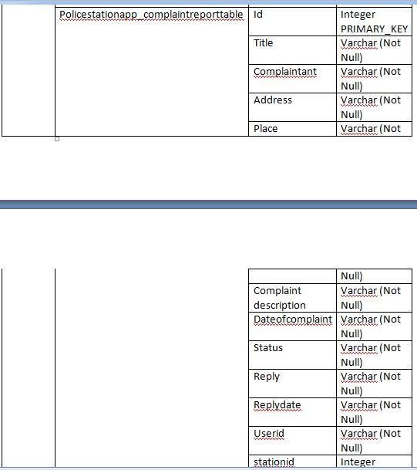

Slide 22
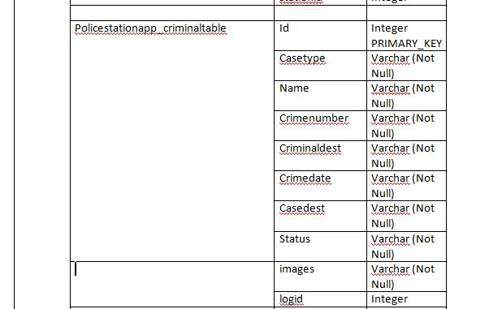

Slide 23
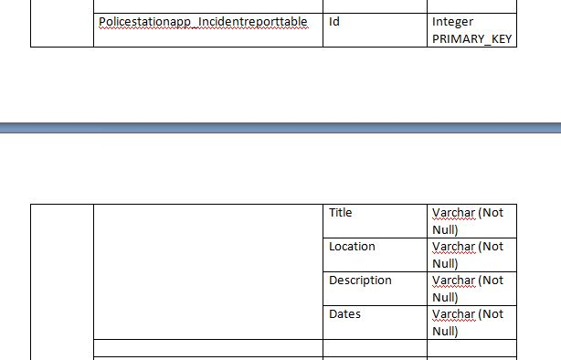

Slide 24
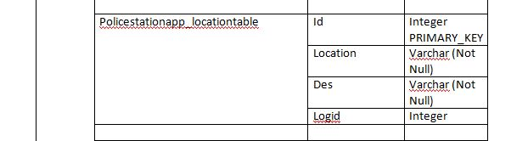

Slide 25
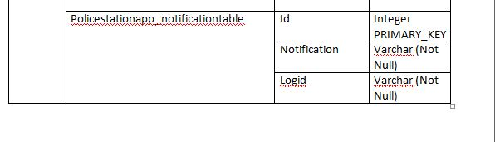

Slide 26
SCREENSHOTS

Slide 27
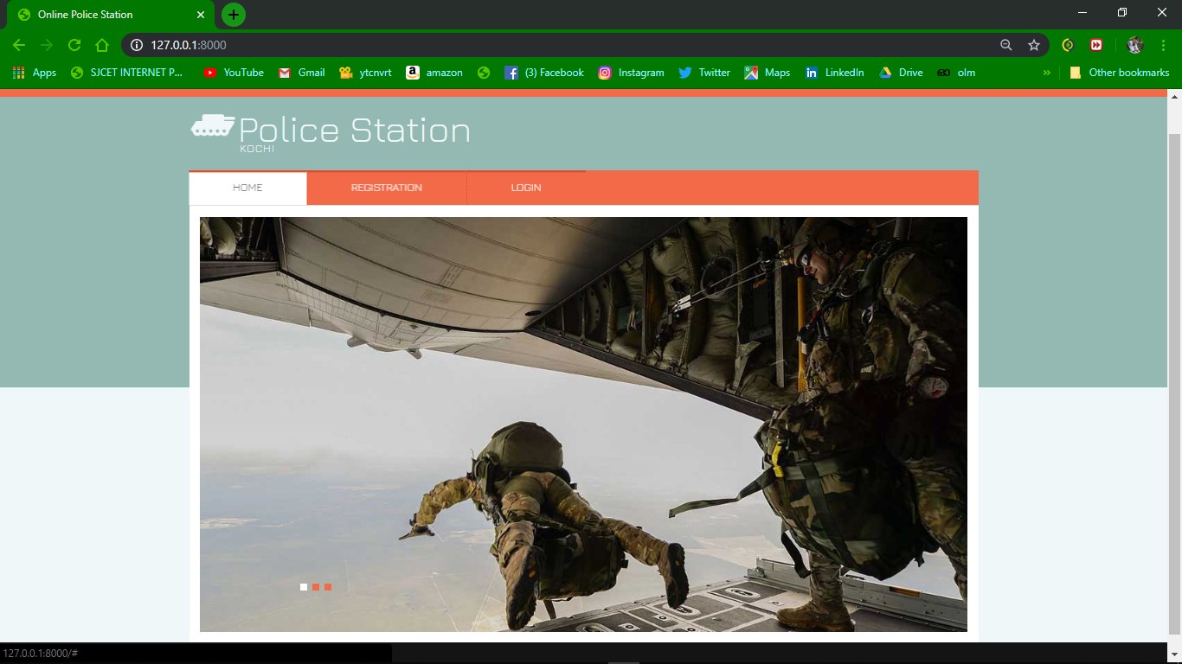

Slide 28
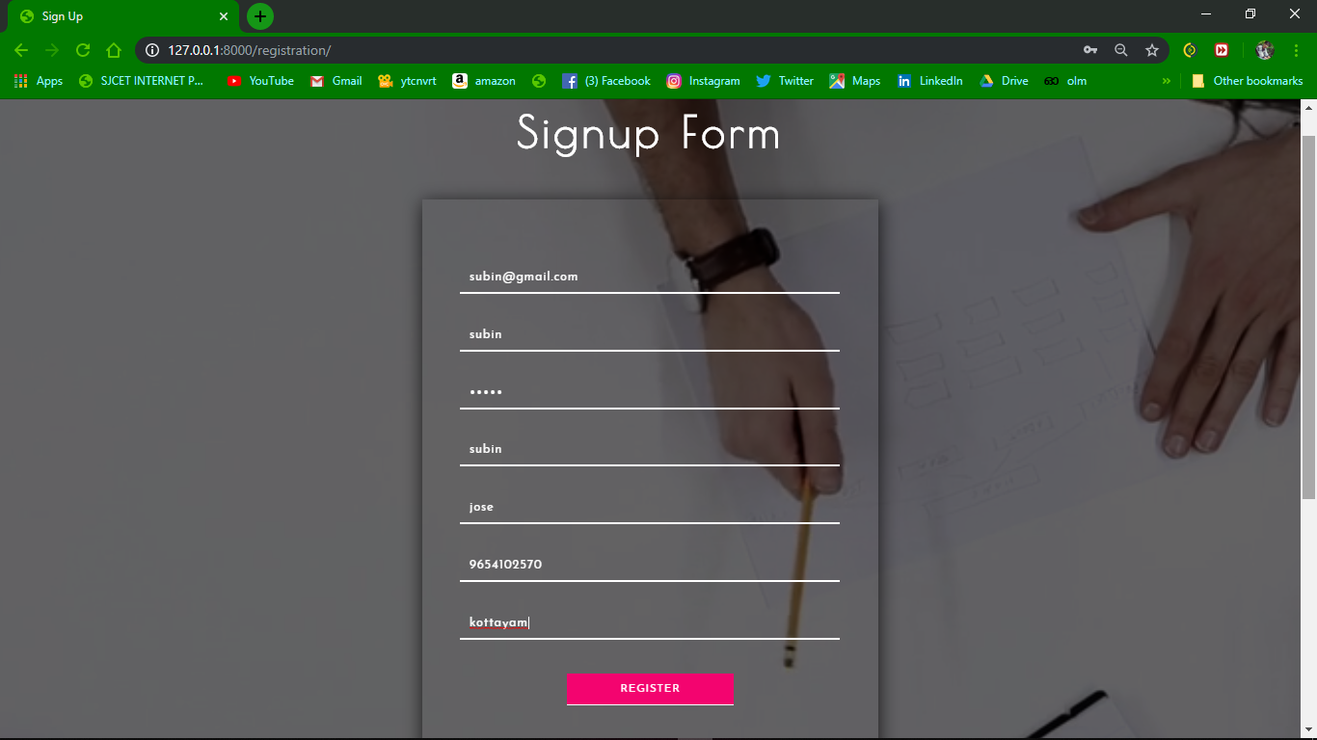

Slide 29
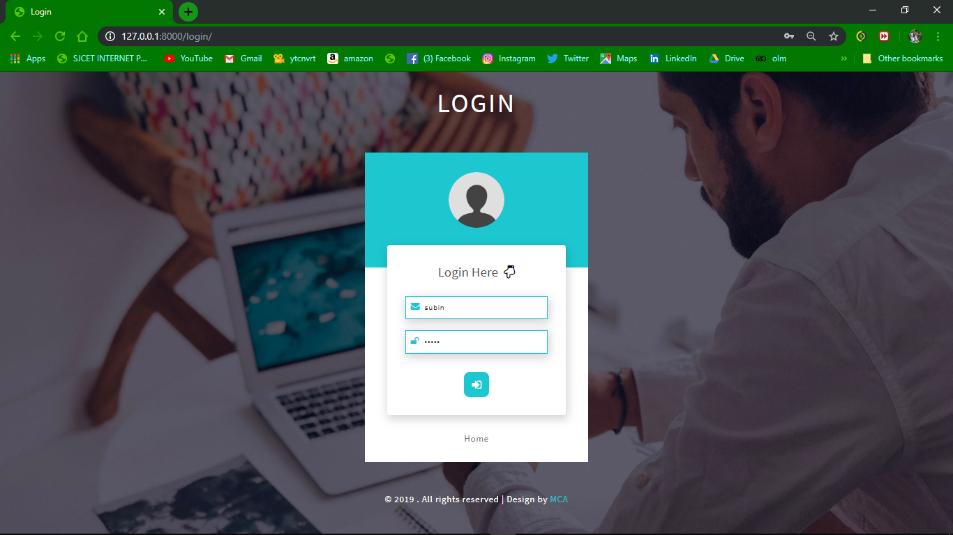

Slide 30
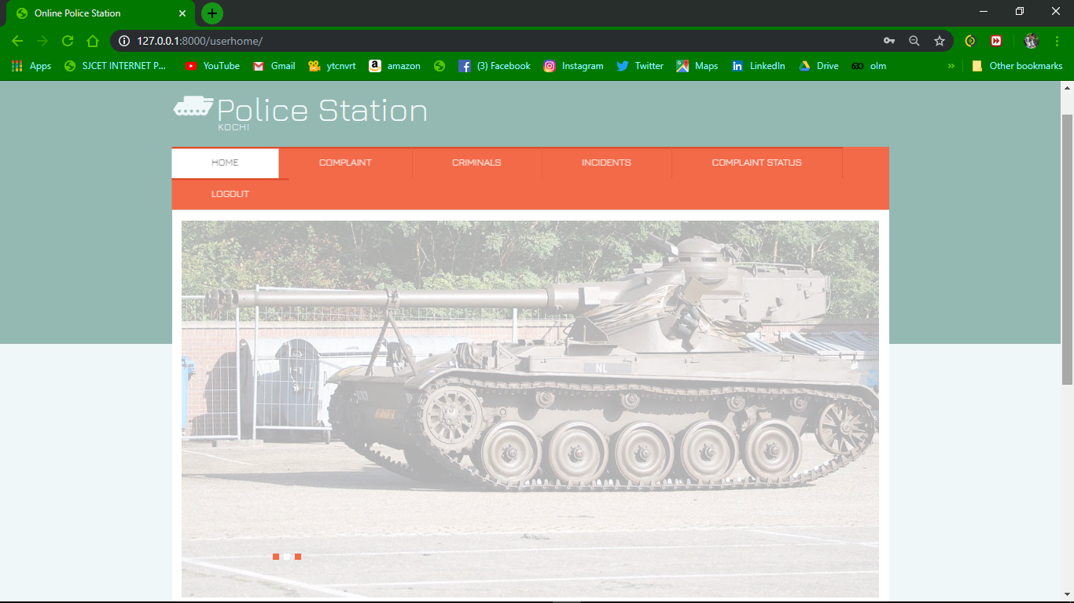

Slide 31
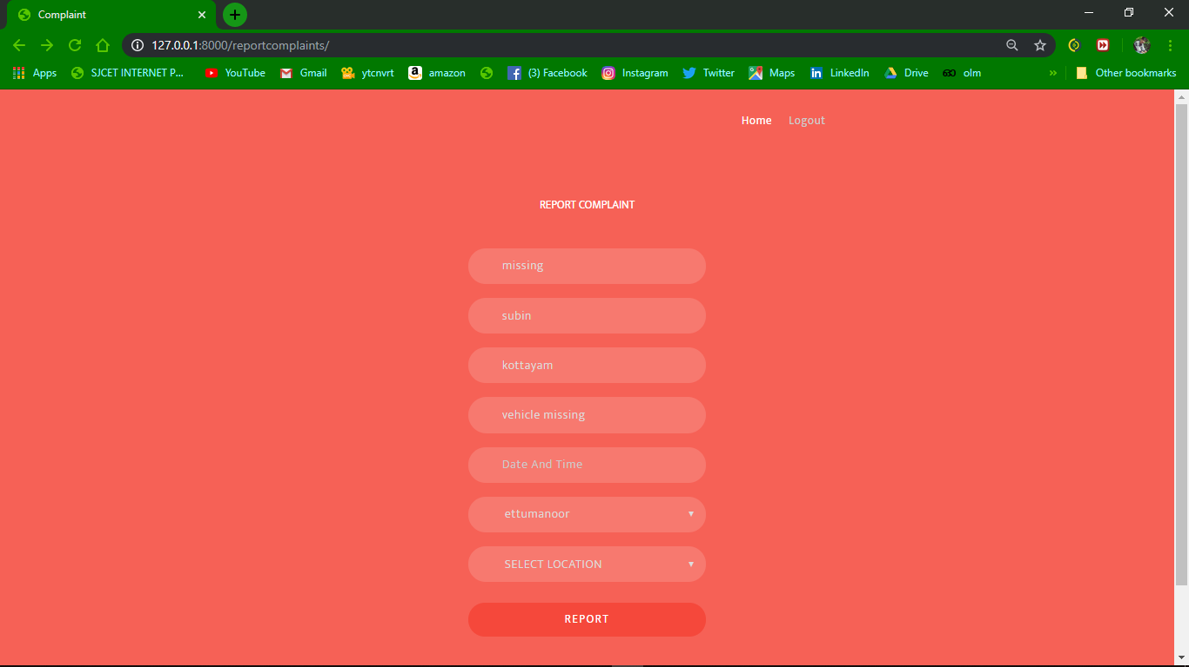

Slide 32
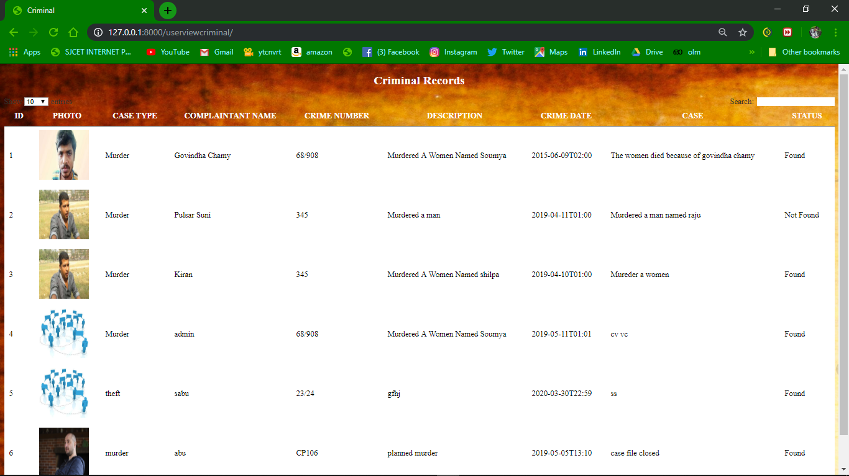

Slide 33
CONCLUSION

Slide 34
Police station system is an application for online police station operations. The users can access the system and do the operations same as the physical police station. This is a virtual police station management and users can reduce the time and efforts.

